Slide 1

Sharing best practices
By
Exar - Reinbouwgroep
28 november 2014
Peter Reinders

Slide 2
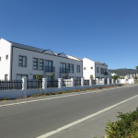
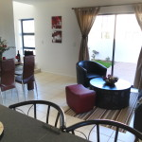


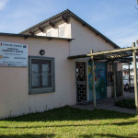
Company Information
2010
Our main focus is the development, construction, renovation, extensions and refurbishment of homes, schools, health centers, community centers, shopping centers and office buildings.
5 + 3 +5 + …..

Slide 3
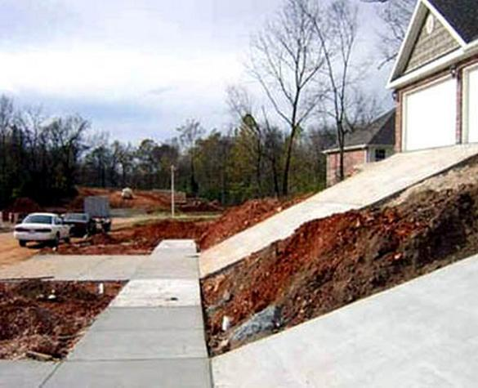
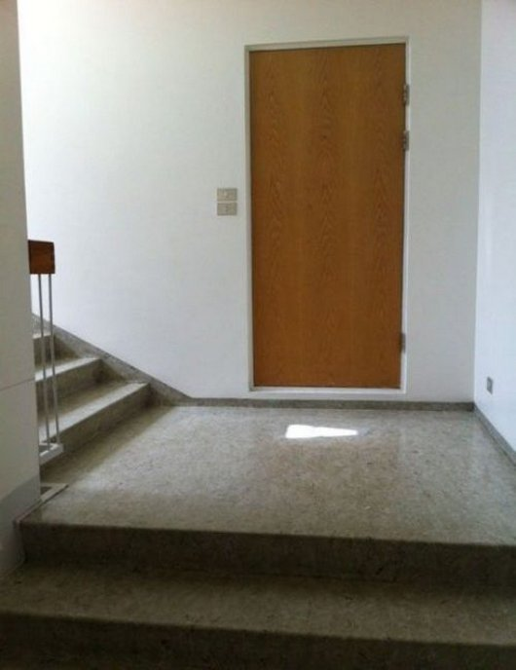
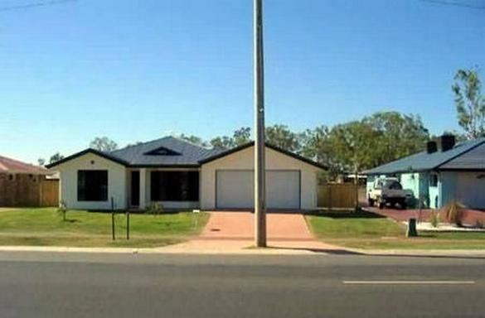
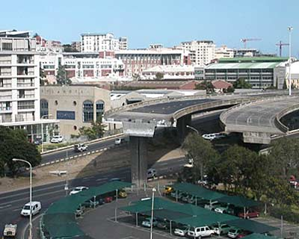
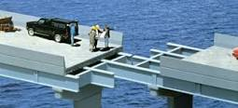

Slide 4
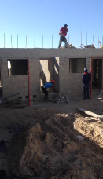
Corporate
Social Responsibility
?

Slide 5
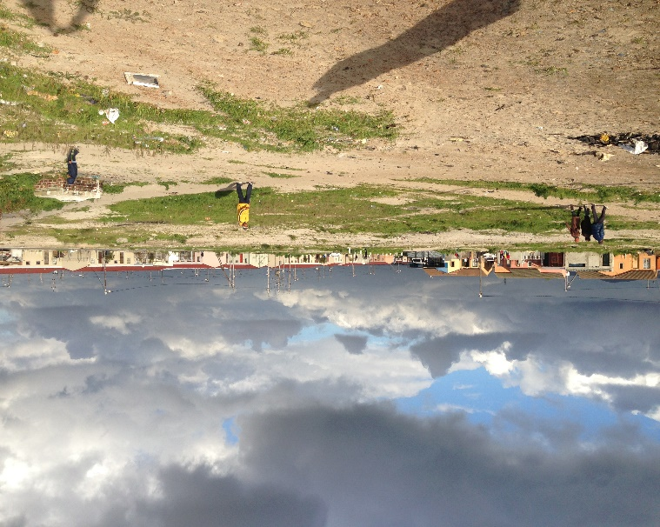
Corporate Social Responsibilty
To realize its full social and commercial potential, South Africa desperately needs housing and job creation. Exar Development & Construction was founded on the vision to make a positive impact on these issues and in so doing transform our country. A vision put into focus through the establishment of a unique partnership between local entrepreneur, Musa Xinwa and Dutch company, Reinbouwgroep B.V.
Werving & Selectie
Opleiding & Training
Health & Safety
Waste & Rubble

Slide 6
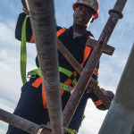
Business Benefit of CSR
Intern:
  Bewustzijn
  Verantwoordelijkheid
Extern
  Marketing
  Community

Slide 7

How to deal with BBBEE
.

Slide 8
Broad Based Black Economic Empowerment
‘Broad-Based Black Economic Empowerment’ means the viable economic empowerment of all black people [including], in particular women, workers, youth, people with disabilities and people living in rural areas, through diverse but integrated socio-economic strategies´
It is not mandatory to get a verification agency to audit a BEE Scorecard. It is however a requirement to have suitable documentation/evidence to score any points.
Ownership
Management
Employment
Skills
Procurement
Enterprise developement
Etc.

Slide 9
How to deal with South African circumstances
Corruption
Bureaucration
Government
Scarcity of Skills

Slide 10
Overheid, Bureaucratie en Corruptie
Overheid
wet en regelgeving
zelfverrijking
preventie
Bureaucratie
Corruptie
frustratie
??
Exar

Slide 11
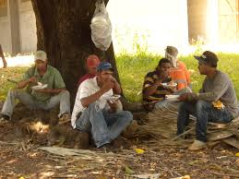
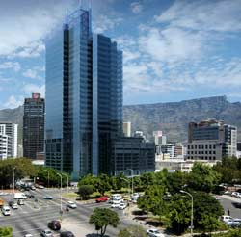
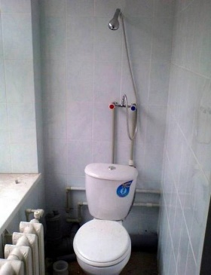
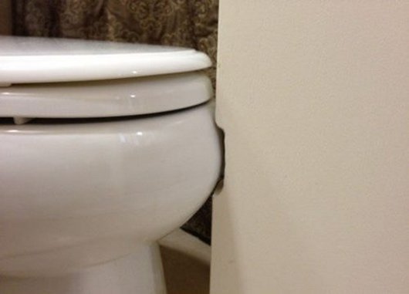

Slide 12
Questions

